Slide 1
FINAL ASSIGNMENT
DXC Technology Vietnam
.Net Fresher Program
Notes:
This template is provided by http://www.free-power-point-templates.com/

Slide 2
Introduction
DXC Technology Vietnam
The members of team:
- Lam Chi Kien
- Nguyen Anh Tuan
Mentor: Nguyen Thai Duy
Topic: Laptop Store

Slide 3
Introduction
DXC Technology Vietnam
Build a laptop store application, include into featuring:
  Register / Login
  Search
  Admin / User authorization
  Add products to cart
  Product, Order, Customer Management
Technology is used:
  Entity Framework, .Net Core 2.0, ASP.NET Web API
  Angular 1 + Angular JS, Bootstrap 3, HTML, CSS, Javascript, Jquery
  Database: SQL Server
  Error Handling, Logging

Slide 4
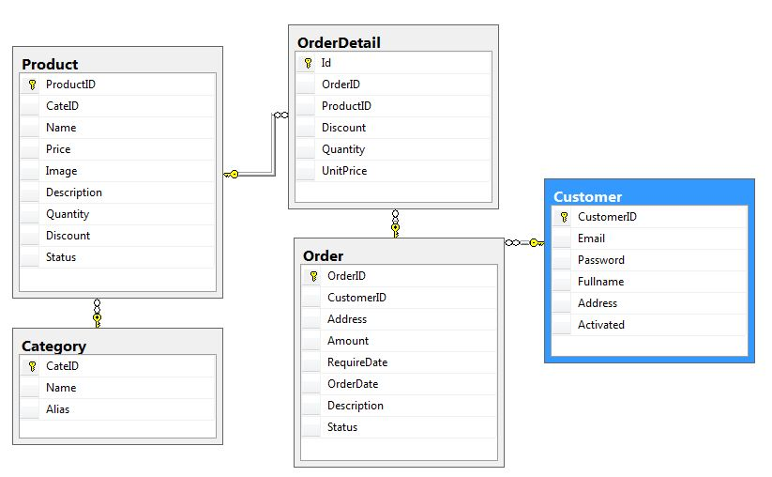
Database Diagram
DXC Technology Vietnam

Slide 5
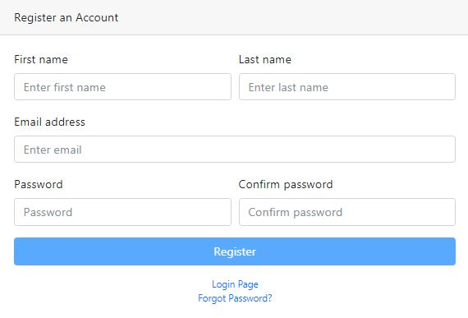
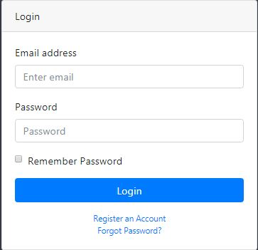
Application overview
DXC Technology Vietnam
Register / Login

Slide 6
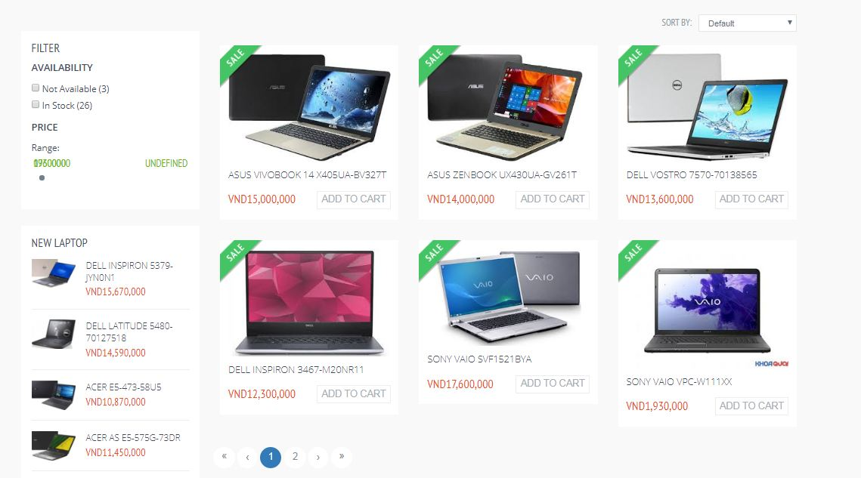
Application overview
DXC Technology Vietnam
Index page (Display all product, when click on product name will display details of that product)

Slide 7
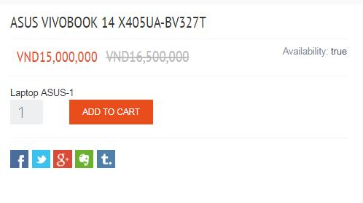
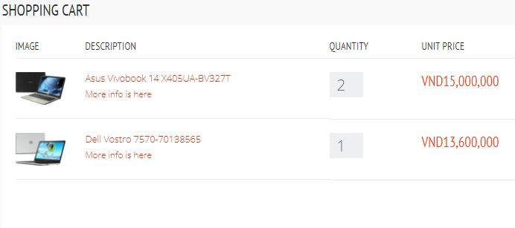
Application overview
DXC Technology Vietnam
Add products to cart (user can login to add any product to cart)

Slide 8
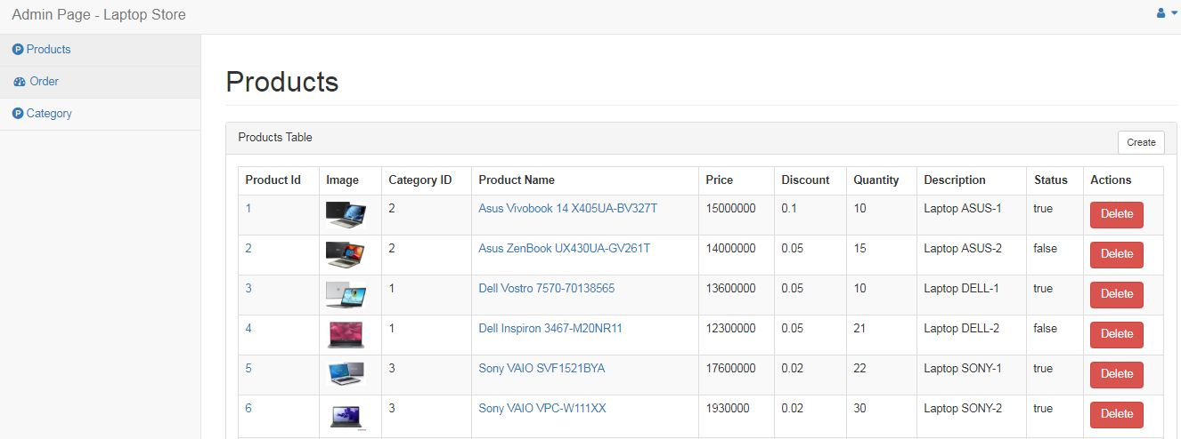
Application overview
DXC Technology Vietnam
Admin can create/read/update/delete a any product

Slide 9
Features for Improvement
DXC Technology Vietnam
Allows multiple products to be selected in the admin page
Categorize products
Orders management
Payment methods
End-user can manager their order on home page

Slide 10
DXC Technology Vietnam
DEMO

Slide 11
DXC Technology Vietnam
THANK YOU
DXC Technology Vietnam
A. Luong Hai Chau
A. Nguyen Thai Duy
For this opportunity to learn and improve
  Lam Chi Kien
  Nguyen Anh Tuan

